Slide 1
ACC Graduation Overview
College Prep
Mr. Gordon
jgordon@bisdtx.org

Slide 2
Upcoming
Events
We have a lot of upcoming events. Please mark these on your calendar.
hi

Slide 3
ACC Gradation Overview
Another valuable resource in ACC Self-Service is Graduation Overview
Here you can:
chart your progress on obtaining your Associate degree
see your most recent ACC GPA,
check your degree plan
Here are the steps to get there.
hi

Slide 4
Graduation Overview
Step 1: Go to austincc.edu and click on “Students”
hi

Slide 5
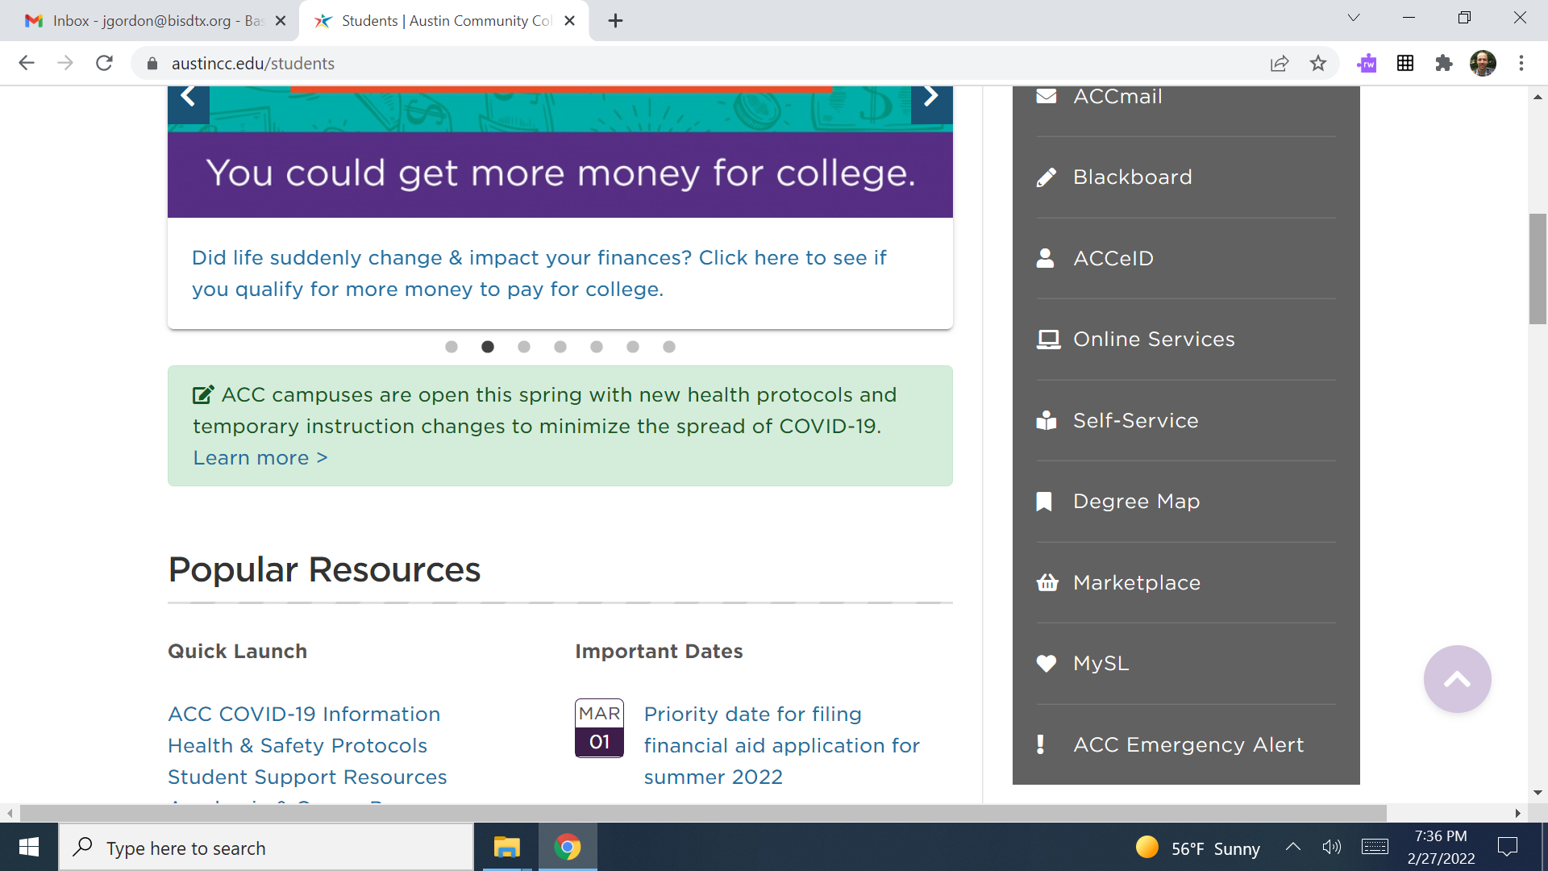
Graduation Overview
Step 2: Click on Self-Service
hi

Slide 6
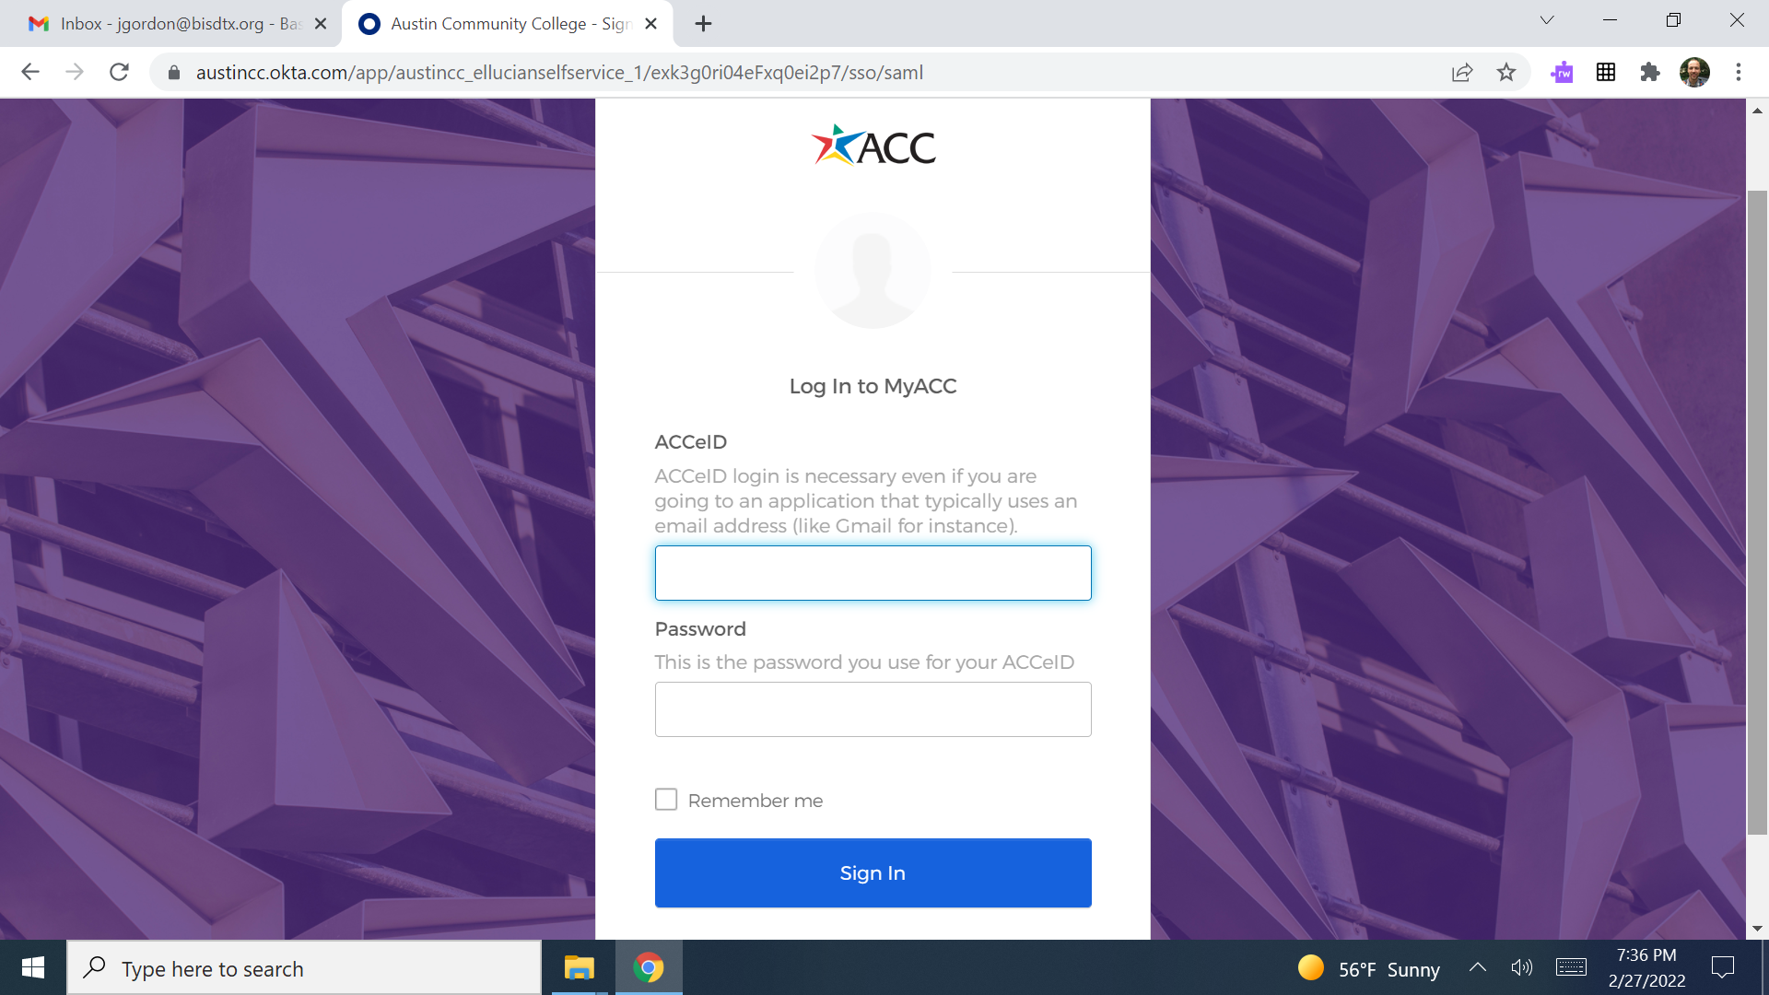
Graduation Overview
Step 3: Log-In
hi

Slide 7
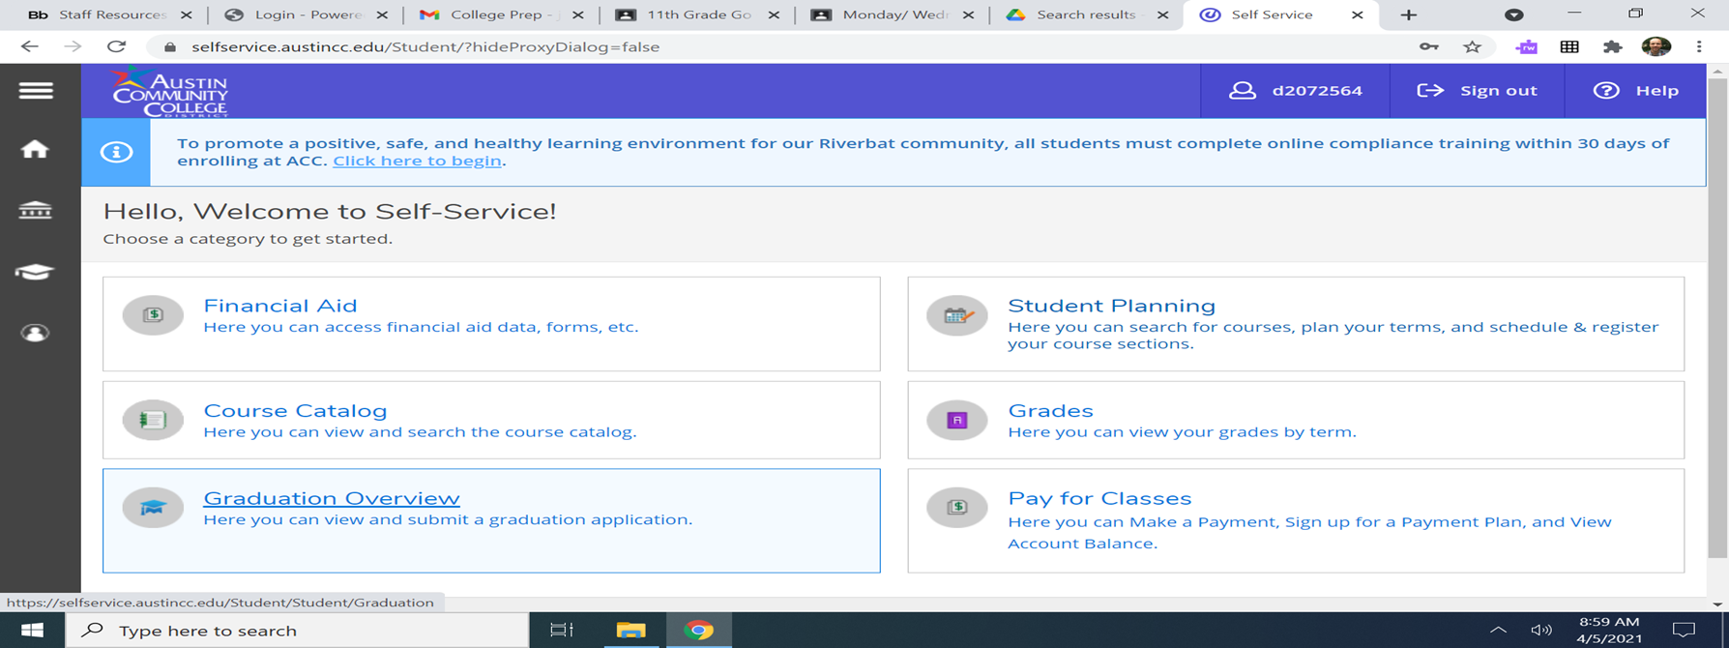
Graduation Overview
Step 4: Once Logged-in, click on “Graduation Overview”
hi

Slide 8
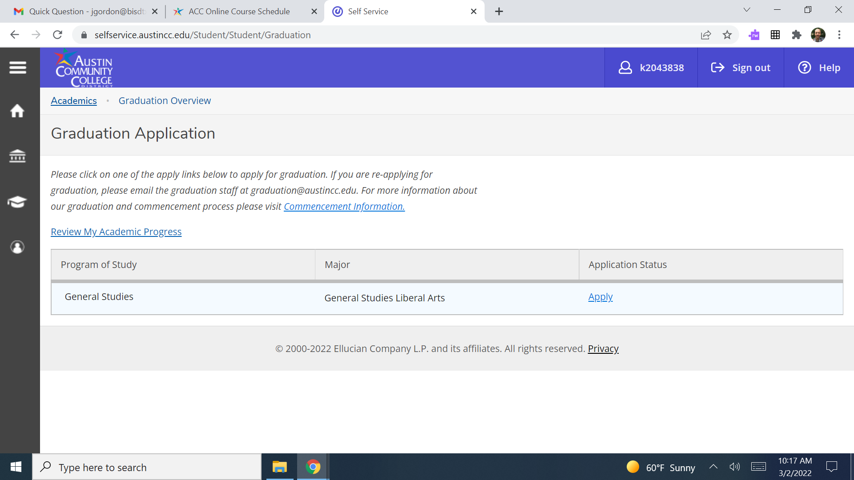
Graduation Overview
Step 5: Click on “Review My Academic Progress”
hi

Slide 9
Graduation Overview
On Review My Academic Progress
GPA- not shown
Red Arrow- degree and major
Ex. Associate of Arts General Studies Liberal Arts
Purple Arrow- Credits completed (dark green)
ex. 26 (this is a Junior)
Blue Arrow- current credits being taken (light green)
ex. 9 (3 classes)
Orange Arrow- credits needed for Associate degree. You must have 60 to get your Associate degree, 15 left
hi

Slide 10
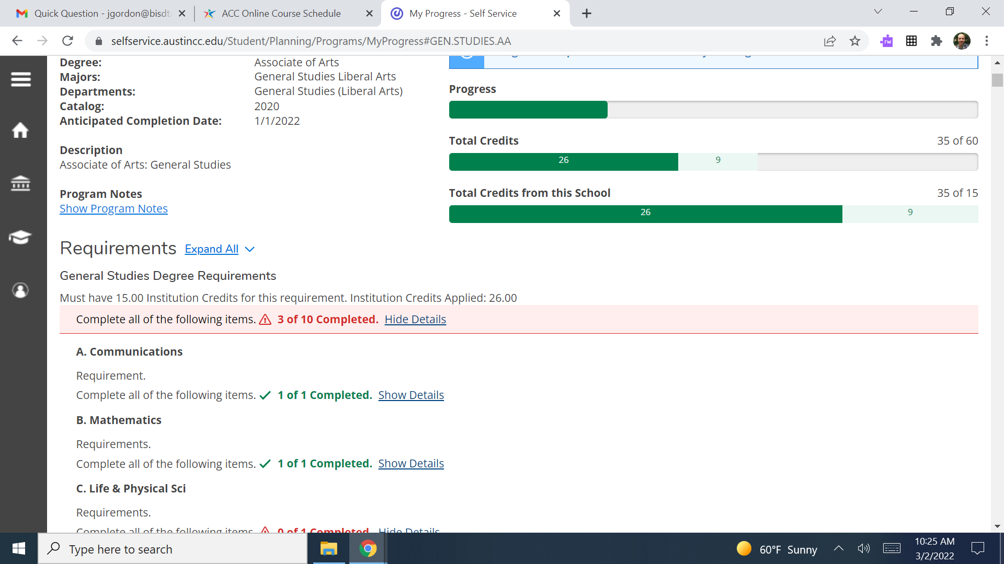
hi

Slide 11
Graduation Overview
Scroll down and you will see the requirements to graduate and how many you have
Red Arrow- completed ex. Speech
Not shown- planned
Blue Arrow- not started ex. Life and Physical Sciences
When all sections are complete, you have completed your degree.
hi

Slide 12
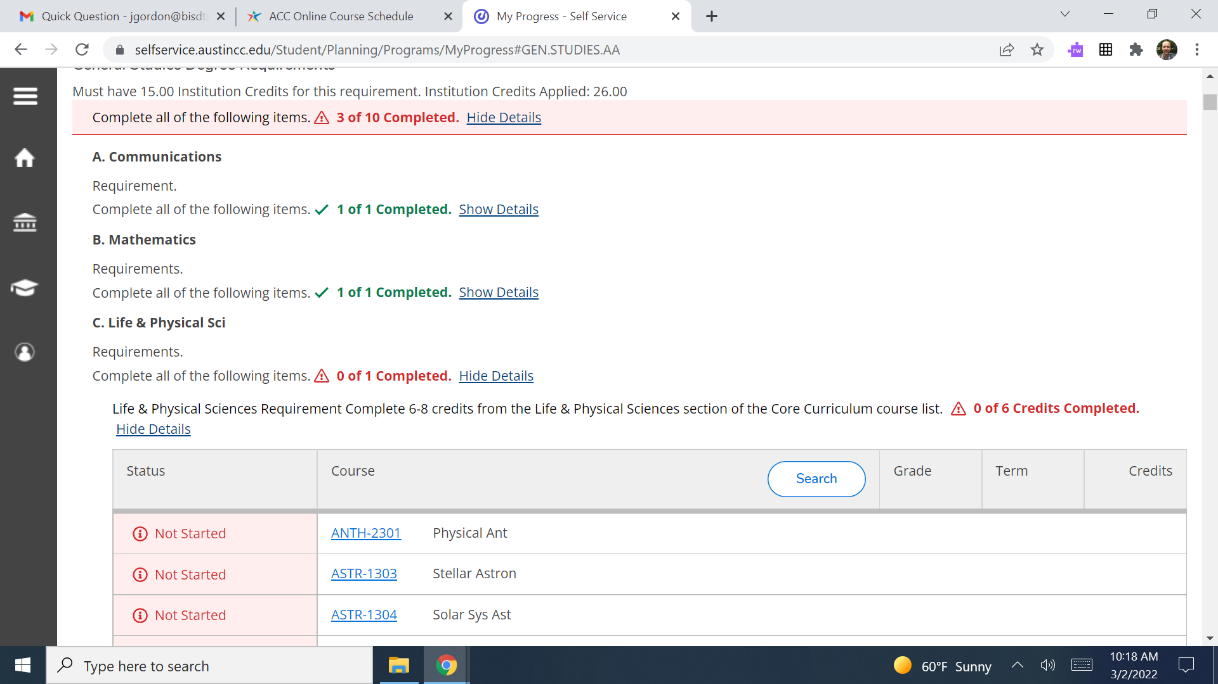
hi

Slide 13
Today’s College Prep Assignment
In the comments section of today’s College Prep,
answer the following question:
What is your degree and major?
hi

Slide 14
Today’s College Prep Assignment
In the comments section of today’s College Prep,
answer the following question:
What is your favorite type of pie?
(don’t say 3.14)
hi

